Slide 1

NBA Lineup Analysis
Jacob Kauffman
Project Three
SMGT 431 – Advanced Sport Analytics

Slide 2
Overview
Introduction
Exploratory Data Analysis
Methodology
Results and Discussion
Conclusion

Slide 3
INTRODUCTION

Slide 4
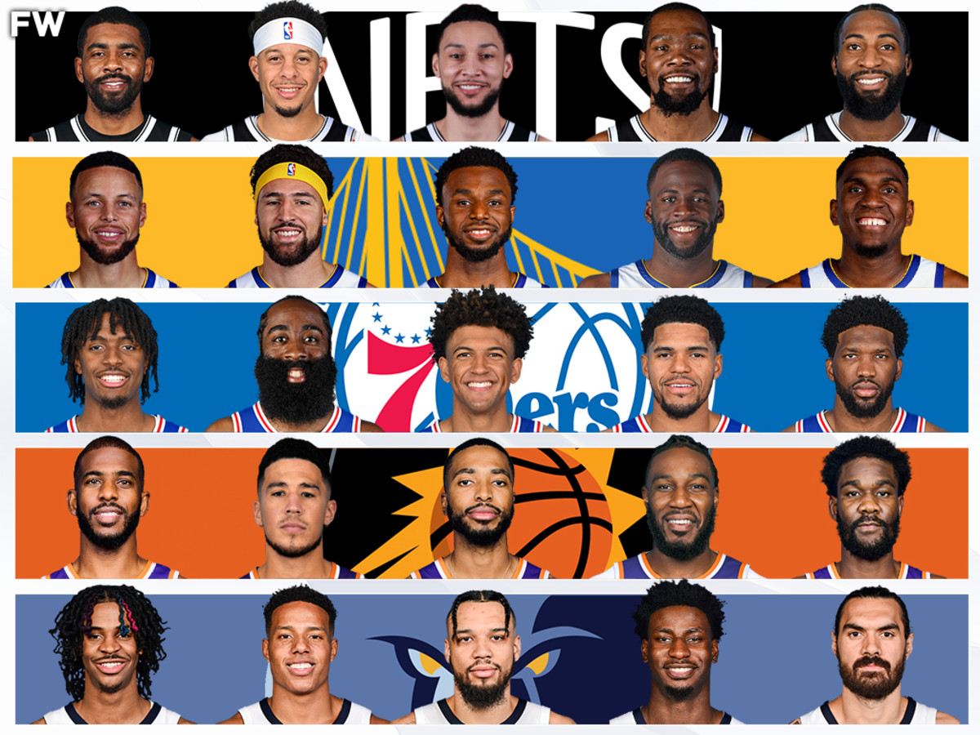
Why Lineup Analysis?
In sports, team performance is rarely the sum of the strength of individual players
Chemistry and Interaction between players often just as important as talent, lineup analysis is a great way to assess this
NBA’s top performing lineups don’t always contain the best individual players

Slide 5
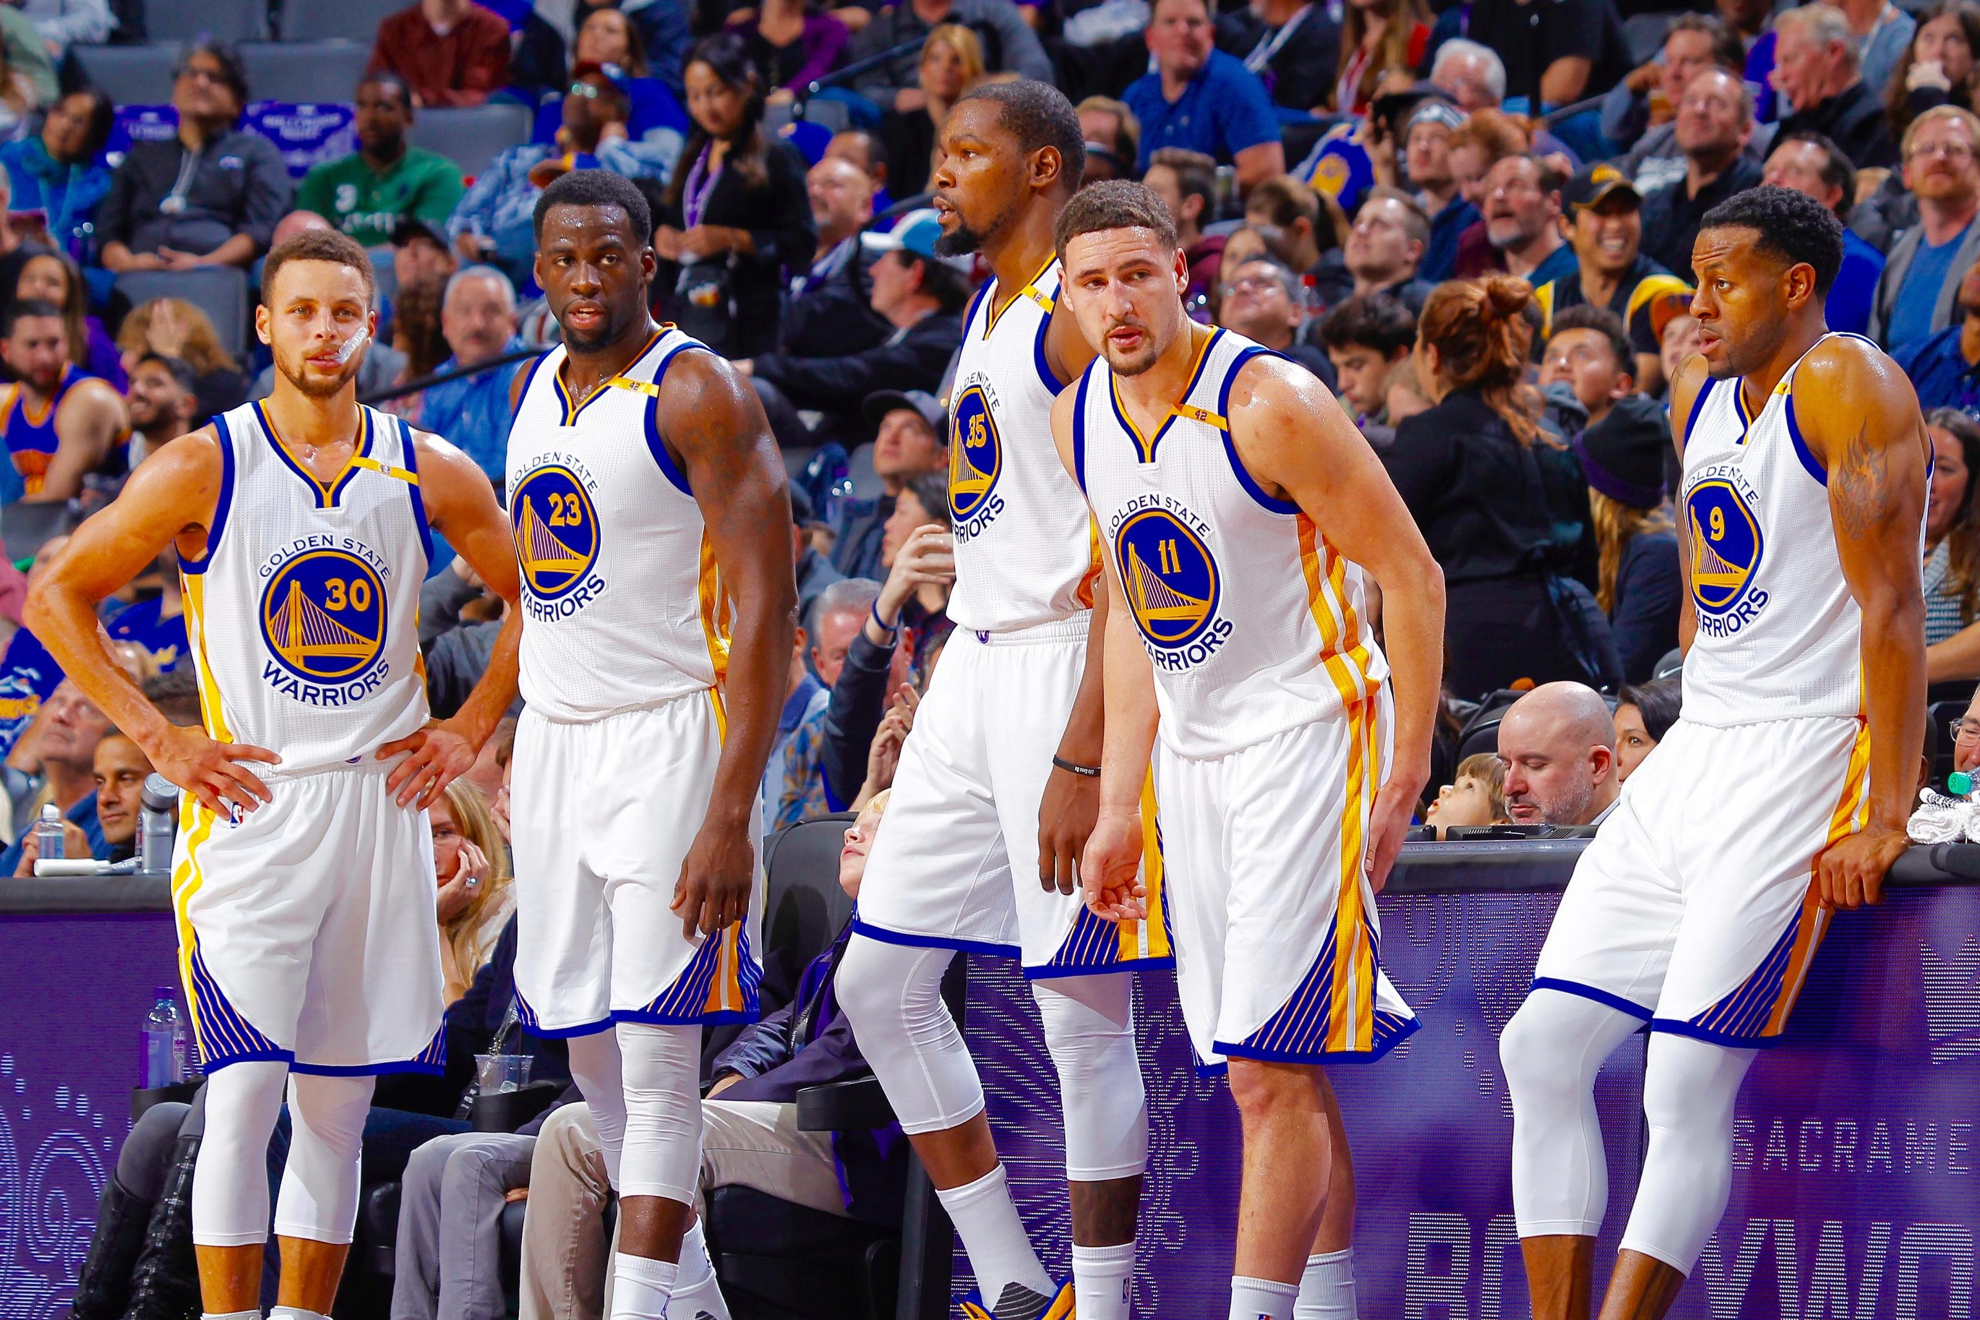
Mathletics’ Take on Lineup Analysis
Discussed in detail in Chapter 32:
In a typical season, a team plays over 500 lineups
Is there a rhyme or reason to coaches lineup decisions?
Do coaches play good lineups as often as they should? Do they play bad lineups too much?
Warriors Death Lineup: Outscored opponents by 29 points per 48

Slide 6
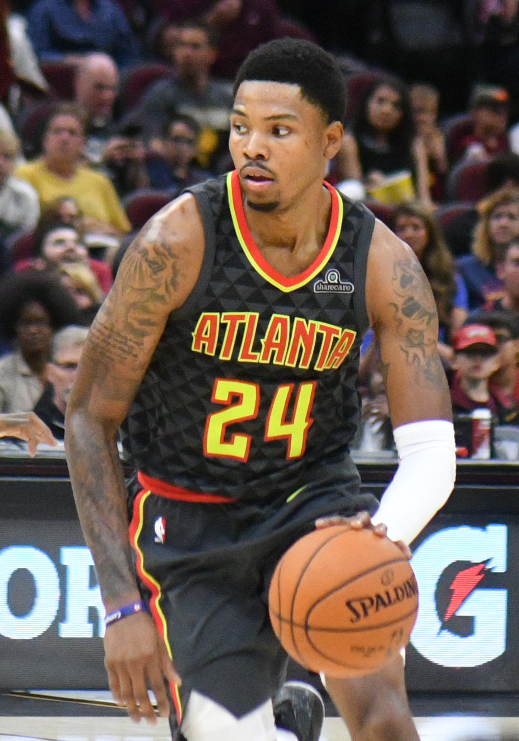
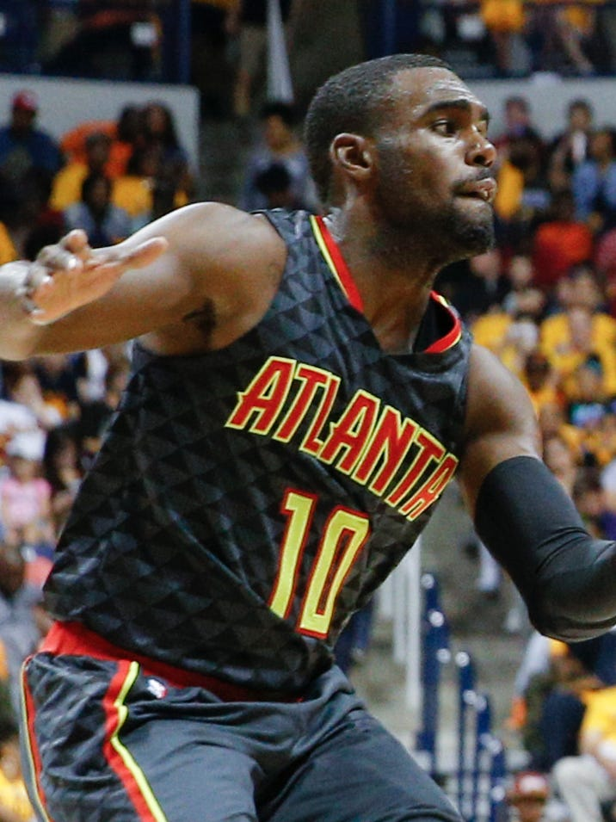
Specific Question to be answered
In the 2016-2017 season, the Atlanta Hawks most played lineup was:
PG:
SG:
SF:
PF:
C:
Dennis Schroder
Kent Bazemore
Thabo Sefalosha
Paul Millsap
Dwight Howard
Though the 2016-17 Hawks were a pretty decent team, this lineup was not particularly good, as they had a Per-48 +/- of -2.4. However by simply subbing in Tim Hardaway Jr. for Kent Bazemore at SG, the lineup increases this number to 28.0. Mathletics asks if the Hawks made a poor decision in playing this lineup ¼ the amount of the Bazemore lineup.

Slide 7
Exploratory Data Analysis

Slide 8
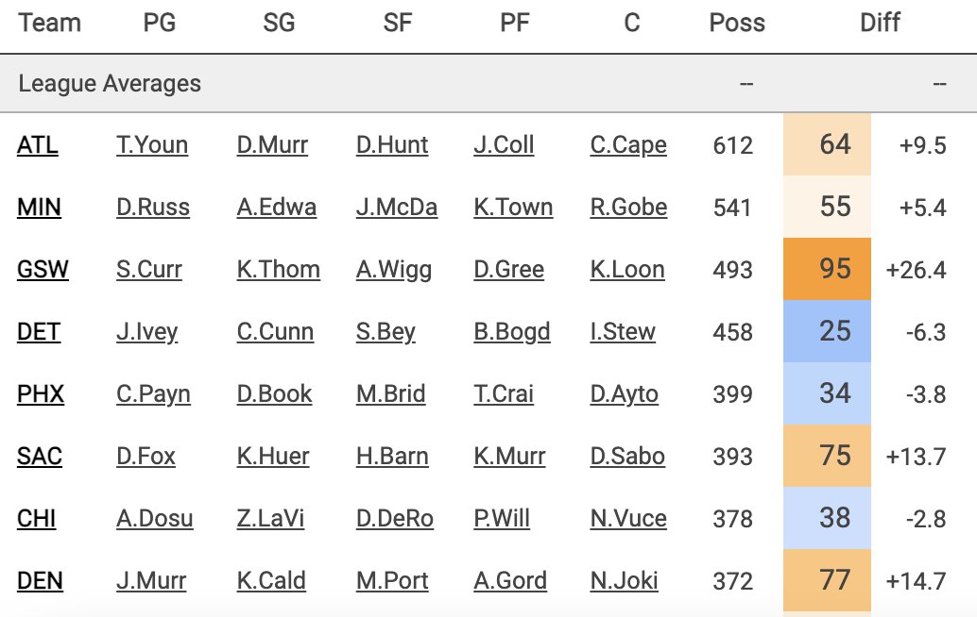
Dataset Background
Data obtained from Cleaningtheglass.com, a fan-maintained public source for NBA data
Contains data from all NBA lineups who played more than 100 possessions in the 2016-17 season (350 lineups)

Slide 9
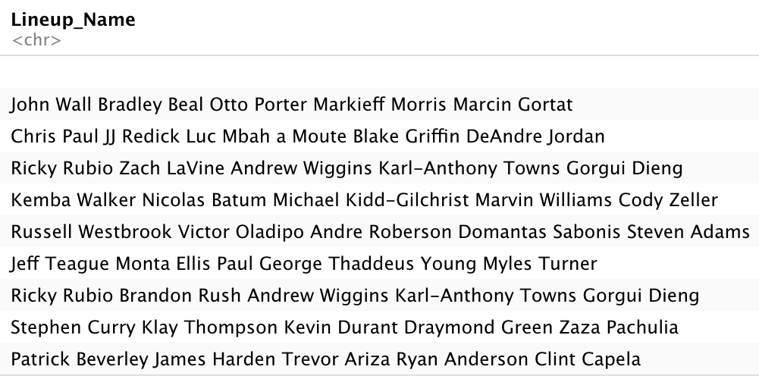
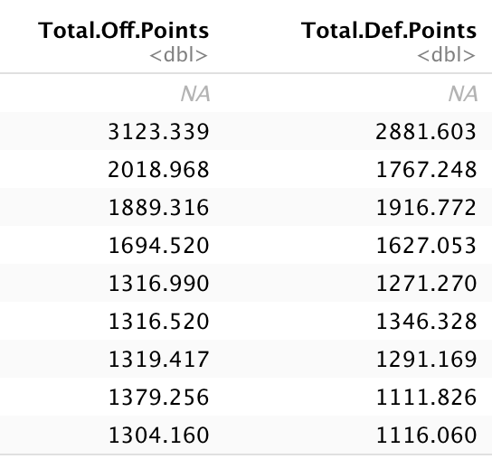
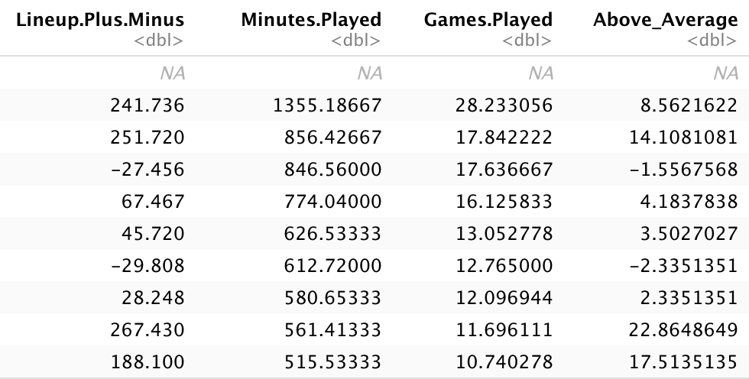
Cleaning Dataset
Biggest obstacles with dataset:
Unlike Mathletics dataset, all data is on a possession basis and not a minutes/game basis
Don’t have aggregates for offensive points/defensive points, only PPP
All the players names are listed in separate columns
Columns that I created:

Slide 10
Exploratory Analysis
Notable Column Means:
Points Per 48 +/-: +3.21
Possessions by lineup: 259.18
Games Played by lineup: 2.67
I also wanted to create visualizations that would help me understand which lineups are playing the most and are most/least effective

Slide 11
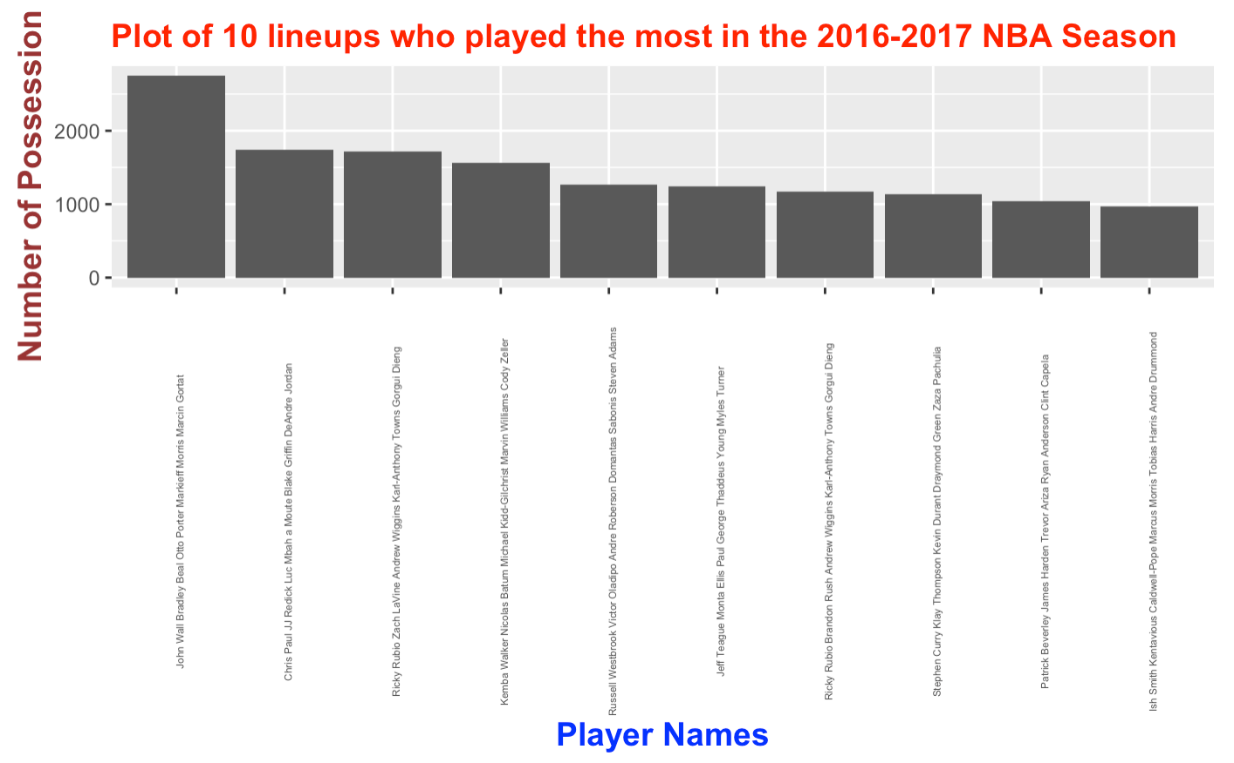

Slide 12
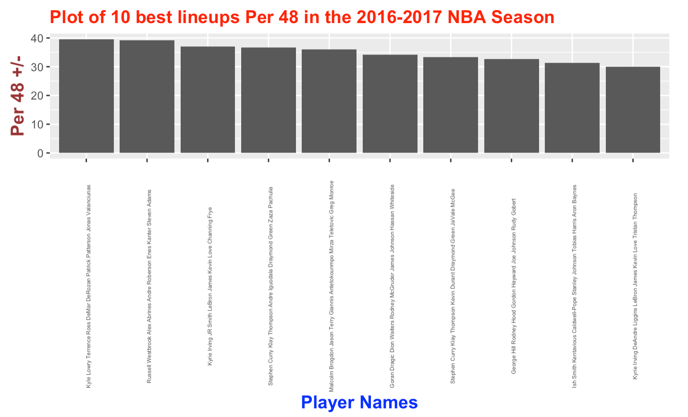

Slide 13
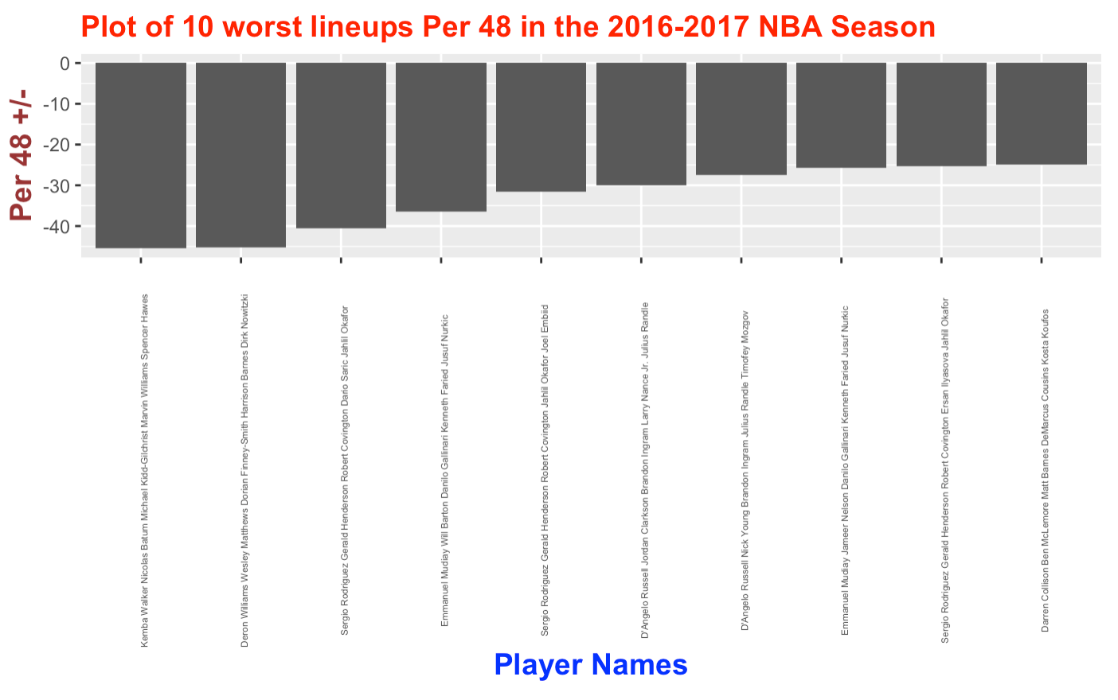

Slide 14

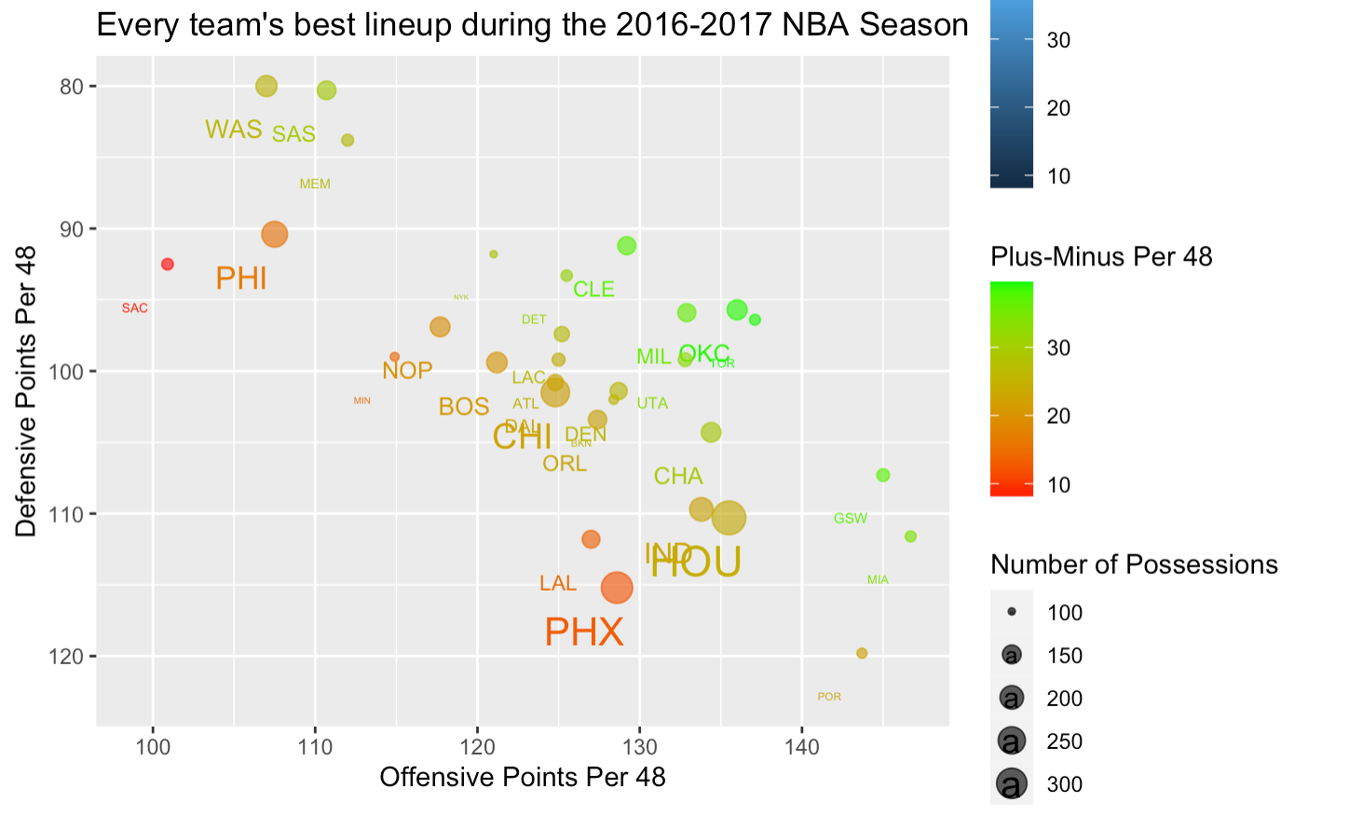

Slide 15
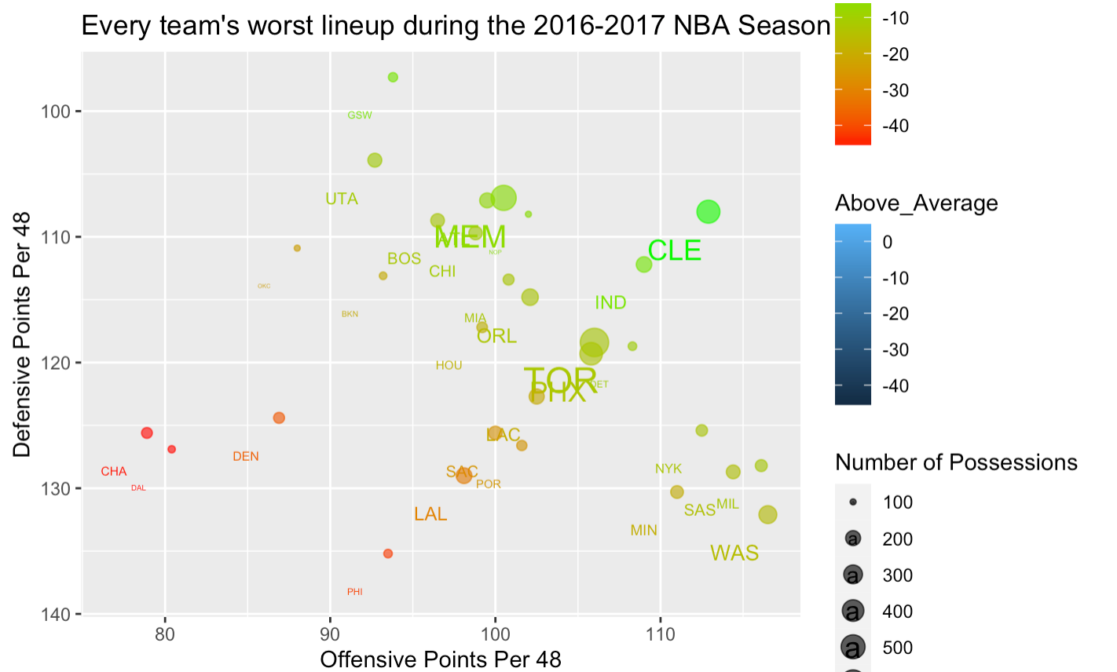
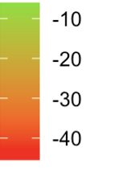

Slide 16
Major Takeaways from Visualizations
Specific:
The best lineup in the NBA wasn’t on a top 5 NBA team, and it lacked any top 20 players in the league
Russell Westbrook’s ability to make a lineup of 4 below average players the 2nd best in the league is incredible
”The Process” 76ers were horrendous (3 of 9 worst lineups)
Scott Brooks (Wizards Coach) REALLY dislikes his bench
General:
The best lineups in the NBA and on a team usually don’t play the highest number of minutes
The best lineups in the NBA weren’t nearly as good as the bad lineups were bad
Teams often play their worst lineups 3x more than their best

Slide 17
Methodology

Slide 18
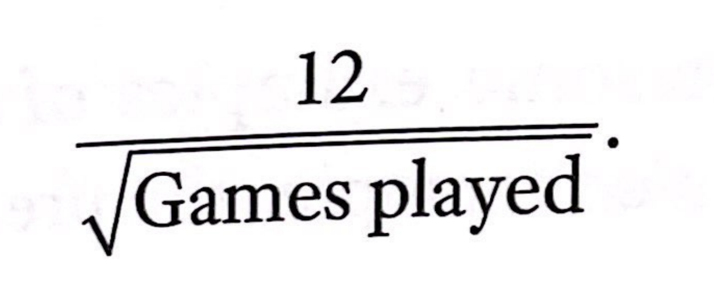
Steps taken to Replicate Analysis
Use the DPLYR Package to clean data and to make it closely resemble the dataset that Mathletics used for their analysis (the most important part of this is calculating points per 48 minutes)
According to Mathletics, indicates that the actual performance of a lineup over 48 minutes is normally distributed with a mean equal to its lineup rating and a standard deviation of 12 points. Thus, the formula to calculate standard deviation of a lineup’s rating is:

Slide 19
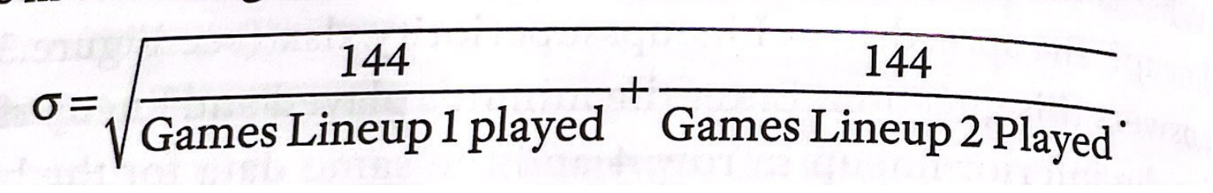
Steps taken to Replicate Analysis
3. The variance of the difference of independent RV’s is the sum of the random variable variances. Since the standard deviation of a RV is just the square root of the RV’s variance, we know that the standard deviation in the rating of the two lineups is given by:

Slide 20
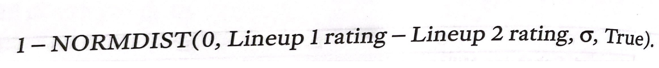
Steps taken to Replicate Analysis
4. We then know that the probability that Lineup 2 is better equals the probability that a RV with mean Lineup 2 rating– Lineup 1 rating and standard deviation σ is greater than 0. I used the R to calculating the probability that:

Slide 21
Results and Discussion

Slide 22
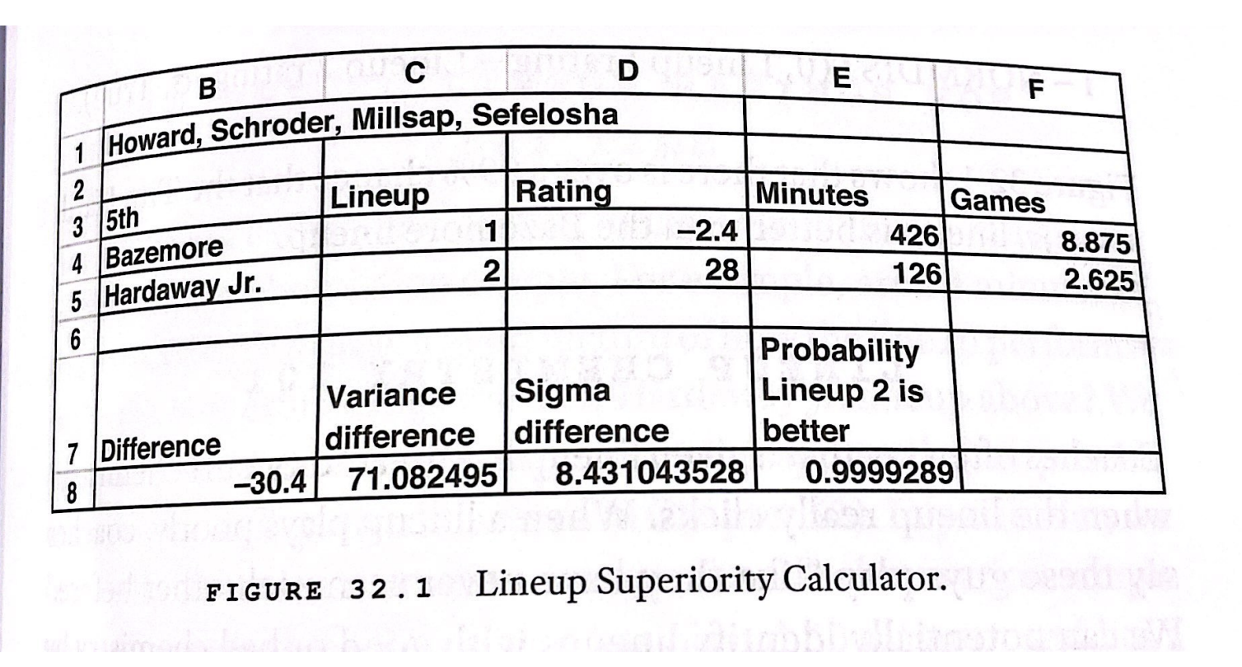
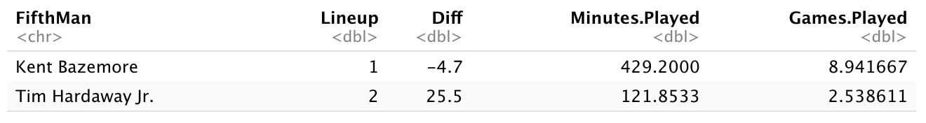
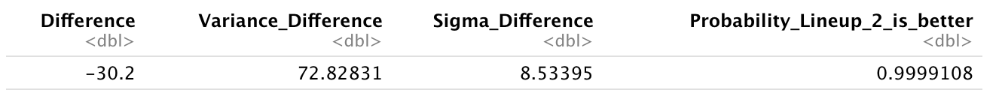
My Analysis vs Mathletics
Mathletics Analysis
My Analysis

Slide 23
Discussion of Results
Results are essentially the same (0.00001 apart), any differences can be attributed to:
1. When doing my data cleaning, I generalized all possessions to take the league average 14.8 seconds. In reality, Atlanta took 14.3 seconds per possession
2. Mathletics dataset probably included playoffs, where the Hawks played 6 extra games
According to both my analysis, and Mathletics, the probability that the Tim Hardaway Jr. lineup is better than the Kent Bazemore lineup is 99.991%.
Thus, it is highly likely that Mike Budenholzer, the former coach of the Hawks, made a mistake in playing this lineup so often/starting them for most of the season.

Slide 24
Conclusion

Slide 25
Conclusion
Performance of specific lineups is crucial in determining team success, perhaps moreso than individual player performance
Teams can see large boosts in performance by simply swapping out one weak link in a lineup:
Specifically, in the case of Kent Bazemore and Tim Hardaway Jr, Mike Budenholzer made a curious decision to play a lineup featuring Bazemore about 4x as much as a lineup with Hardaway Jr., even though Hardaway’s lineup was significantly more effective.

